Slide 1


SDD of invoice management
Name – yashi gayakwad
Subject – system analysis and design
Roll no. –IT- 2k19-74

Slide 2
System design description of invoice management
To design an invoice, small businesses need to create a professional-looking invoice template. A well-designed invoice will reflect well on your brand and can help motivate clients to pay quickly with a clean, easy-to-read invoicing format.

Slide 3
Invoice design basics you’ll need to know to make professional invoices:
How to Design an Invoice
Invoice Design Theory 101
What Does a Professional Invoice Look Like?

Slide 4
How to Design an Invoice
1. Design the Invoice Structure
2. Include Your Brand and Style
3. Make the Information Readable
4. Leave Room for Descriptions
5. Make Deadlines and Payment Totals Stand Out
6. Clearly State Payment Terms

Slide 5
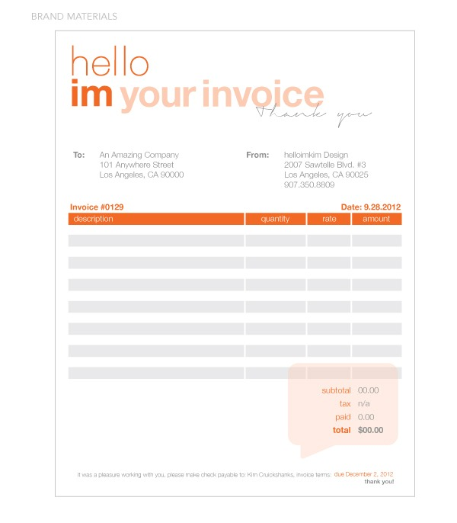
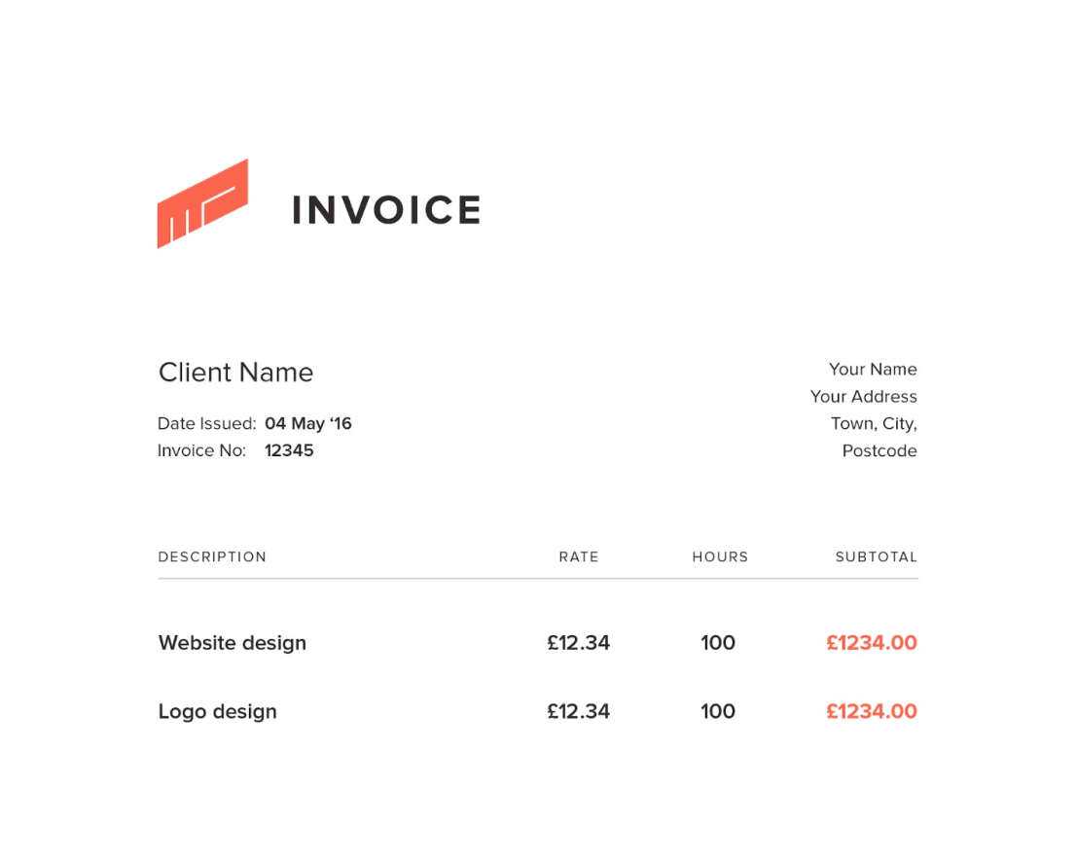

Slide 6
Invoice Design Theory 101
There are three pieces of information you want to make sure your clients notice at a glance as soon as they open your invoice:
Who the invoice is from
How much money they owe
When they need to make the payment by

Slide 7
What Does a Professional Invoice Look Like?
This is the information that needs to be included on a professional invoice:
The business’s name and contact details with a logo, if applicable
The client’s name and contact details
An invoice number
A payment due date
A detailed list of services provided with descriptions, quantities, rates and subtotals
The total amount due on the invoice
The payment terms

